Slide 1

Quick Guide to Scientific Publishing
PhD. Jimy Alexander Cortés Osorio
Editor of the Scientia et Technica journal
jacoper@utp.edu.co

Slide 2

What is a scientific and technological research project?
“It is one that refers to an articulated and coherent set of activities aimed at achieving one or more objectives related to the generation, adaptation, or creative application of knowledge” [6].
“For this purpose, a defined methodology is followed, which aims to achieve specific results under limited conditions of resources and time, specified in a budget and schedule, respectively” [6].

Slide 3

Scientific Research
Specificity
Objectivity
Novelty
Usefulness
Reproducibility
Falsifiability
A scientific research article must implicitly address these criteria.

Slide 4

Specificity
“Research should refer to a clearly defined object, applying its conclusions, in principle, only to that object”
[1].“Research addresses an object that is identifiable and defined in such a way that it is also recognizable to others”
[1].The object can be abstract or physical.

Slide 5
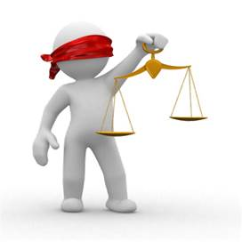
Objectivity
“One should not assert anything for which data, evidence, or justifications capable of being tested cannot be provided” [1].

Slide 6

Novelty
“Research should aim to say something new or address something already known from a fresh perspective.”
“A compilation can be scientifically valuable if the compiler has organically gathered and correlated opinions previously expressed by others on the same topic. Such work is only meaningful if no similar compilation already exists in that field” [1].

Slide 7

Usefulness
“Research should serve someone, not merely in terms of practical, material, or monetary utility, but rather as knowledge essential for achieving further knowledge” [1].
“Kepler’s discoveries would not have been possible without conic sections. Kepler’s contemporaries, such as Descartes and Pascal, gradually abandoned the study of geometry, arguing that it was COMPLETELY USELESS” [1].“

Slide 8

Reproducibility
“Any other researcher should be able to replicate a given study, whether to arrive at the same results or to identify shortcomings that need to be overcome” [1].
“In experimental research, this requirement is met by describing experiments in detail, enabling others to replicate them” [1].

Slide 9

Falsifiability
Definition of Falsifiability: A scientific statement must be capable of being subjected to empirical testing to determine whether it is true or false.
Importance of Falsifiability: Falsifiability is a criterion that allows distinguishing between science and non-science. A statement that cannot be refuted through experimentation is not scientific.
Example of Falsifiability: Generalization: "All swans are white." Falsification: Look for a swan that is not white.
The Falsification Process: If we find just one swan of another color, the generalization is refuted. We do not need to verify that all swans are white; only one counterexample is necessary to invalidate the statement.
Establishing a Scientific Law: If a statement withstands multiple and varied attempts at refutation without being falsified, it may eventually be considered a scientific law.
Critical Thinking: Falsifiability encourages critical thinking and ongoing research, preventing the blind acceptance of statements.

Slide 10
Personal reasons for publishing
Graduation requirement.
Career advancement.
Improved income.
Increased personal and scientific recognition.
Not considered by journal editors

Slide 11
Scientific Reasons for Publishing Research
To share information with the scientific community that enhances understanding in a specific field.
To present new or original results and methods.
To reflect upon results intended for publication.
To present a review of the field or summarize a particular topic.

Slide 12
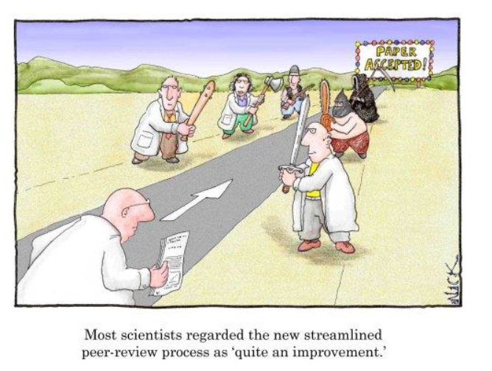
You must be prepared!

Slide 13
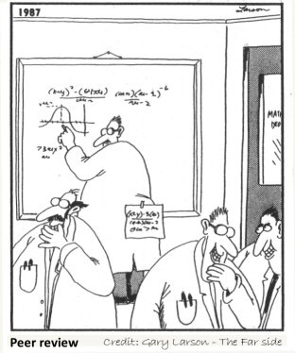
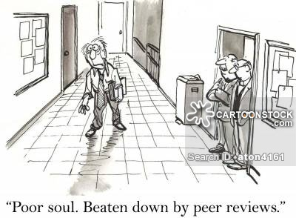
Peer Review (Dark Humor)

Slide 14
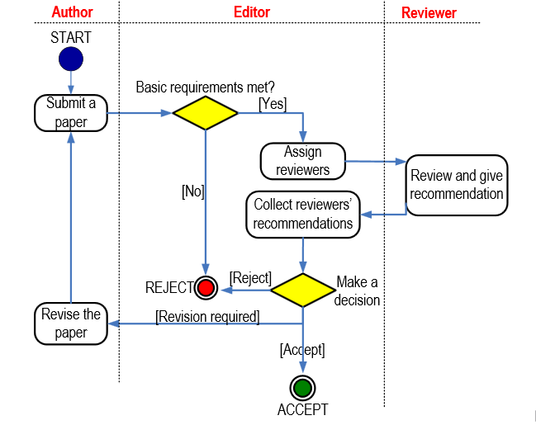
Publication Diagram

Slide 15
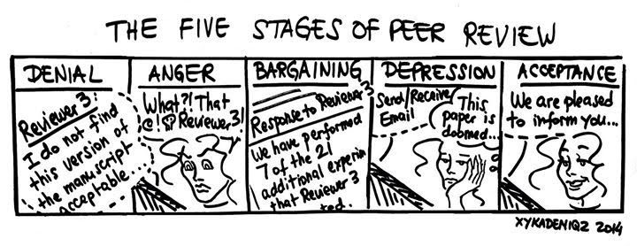
Peer Review (Dark Humor)

Slide 16
Before writing the article
Is this an important problem?
Is the collected information of interest to the scientific community?
Does the collected data contribute meaningfully to scientific understanding?
Is this research addressing a relevant gap based on existing knowledge?

Slide 17

Questions to answer
Yes No
✓
Is this an important problem?
Is the collected information of interest to the scientific community?
What has been done in the past?
Does this research provide any significant advancement in the field?
✓
✓
✓
If the answers to these questions are yes, proceed to write the manuscript!

Slide 18
Literature Review
Becomes largely the references section of the article.
References can later be used in the introduction or discussion sections.
Provides experience for writing scientific articles.
Guides the direction of scientific manuscript writing.

Slide 19

The public
Is it specialized, multidisciplinary, or general?
Is the topic of global or local interest?

Slide 20
Journal Selection
Define the scope (national or international).
Main topic of interest (Mathematics, Physics, Signals, etc.).
Type of article (scientific, review, etc.).
Evaluate the journal category (A, A2, B, C, or non-indexed).
Submit the article only once (no simultaneous submissions).
There is no universal formatting guideline for journals, only some common criteria.

Slide 21
IMRaD Format (IMRyD in Spanish)
Introduction
Methods
Results
Discussion
It is the format adopted by scientific journals and researchers for publishing their manuscripts.

Slide 22
Sections of the article (presentation)
Title
Author information
Abstract (maximum 250 words)
Key words

Slide 23
Sections of the article (Main body - mandatory)
Introduction
Methodology
Results
Discussion

Slide 24
Sections of the article (Ending)
Conclusions
Acknowledgements
References

Slide 25
Recommended Writing Order
Methods
Results
Figures and tables
Discussion
Conclusions
Introduction
Title and key words

Slide 26
Methodology – general recommendations
Tense and Sequence: Write in past tense and follow a chronological sequence to describe how the study was conducted.
Objective of the Methodology: Explain in detail the approach used to address the research question. This underpins the validity and reliability of the obtained results.
Reproducibility and Clarity: Provide sufficient detail for others to replicate and understand your study.
Citations and References: Even if the method is widely known, include precise bibliographic references for verification and follow-up.
Bioethical Considerations: Clearly mention relevant ethical considerations, including ethical approval if required.
Results Separation: Do not include results in this section; reserve them exclusively for the Results section.

Slide 27
Methodology – elements to be included
Object of study: Clearly specify whether the research object is abstract or physical, ensuring it can be recognized and defined by others.
Variables and Initial Conditions: Provide details of influential variables and their relevant initial states, such as temperature, pressure, lighting, and time, among others.
Study Location: Provide specific geographical data about the research site, including latitude and longitude coordinates, city, and region.
Data Analysis Approach: Indicate whether a quantitative or qualitative approach was used, including the specific statistical techniques applied to data analysis.
Relevance and Context of the Experiment: Include only pertinent information that clearly illustrates the circumstances and context in which the research was conducted.
Ethical Considerations: Mention relevant bioethical considerations, including ethical approval if required.
Sampling and Variables: Clearly describe influential variables and their initial states (e.g., temperature, pressure, illumination, duration).
Study Objective: Explain clearly the approach taken to address the research question, establishing the validity and reliability of the findings.
Study Timeline: Write in the past tense and follow a chronological sequence to describe how the study unfolded.

Slide 28
Methodology – Possible Sections
Materials: List specific supplies and reagents used.
Equipment: Detail instruments and technologies employed.
Environmental Conditions: Describe experimental conditions such as temperature, humidity, and illumination.
Experimental Protocol: Explain the procedure followed, step by step.
Analytical Strategies: Identify quantitative and qualitative techniques used for data analysis.
Optional subsections can be added to accommodate the specificity and requirements of your research.

Slide 29
Results
Timing and Approach: Results are presented in the past tense, reflecting observations made during the study.
Centrality: This section forms the core of the article, presenting key data obtained.
Evidence and Falsifiability: Provides evidence supporting or refuting your hypothesis, emphasizing the scientific rigor of the study.
Data Visualization: Utilize tables and figures to highlight your findings, avoiding duplication of information to maintain communication efficiency.

Slide 30
Interpretation of Results: Ensure that your results accurately illustrate patterns, proportions, correlations, and extremes.
Organization: Present findings in a sequential and logical manner, setting the stage for discussion and conclusions.
Clarity in Presentation: Each table and figure must have properly labeled axes and units to ensure unambiguous interpretation.
Scientific Integrity: Do not omit results that contradict the hypothesis. An honest and complete presentation is essential for scientific progress.

Slide 31
Discussion
Contextualization of Findings: This section aims to place the study’s results in their appropriate context.
Illustration of Observed Relationships: Presents the connections between the observations made during the study.
Highlighting Significant Results: It is recommended to first emphasize the most relevant findings obtained in the research.
Comparison with Similar Studies: The results are then compared with those of other similar studies mentioned in the introduction.

Slide 32
Objective Justification of Differences or Similarities: It is important to objectively justify the discrepancies or similarities between this study’s results and those of other authors.
Avoiding Speculation Without Evidence: The discussion should avoid speculations that are not supported by the obtained results.
Identification of Exceptions or Lack of Connections: Present any exceptions or the absence of connections found in the results without forcing relationships that lack evidence.

Slide 33
Conclusions
Response to the Stated Problems and Objectives: The conclusions provide a direct answer to the problems and objectives established in the introduction.
Minimum Number of Conclusions: At least as many conclusions are presented as the number of objectives initially stated.
Support in Results Without Repetition: These conclusions are supported by the study’s results without repeating them, instead contextualizing them in relation to the established objectives.
Explicit Acknowledgment of Limitations: Any limitations of the study are explicitly stated to ensure a proper understanding of the research’s scope.

Slide 34
Future Work Proposal: Future research is suggested to further explore the areas identified during the study.
Exclusion of Unproven Conclusions: Conclusions that have not been experimentally tested in the study are avoided.
Separation of Conclusions from Discussion: Although they are often presented together, it is considered beneficial to separate the conclusions from the discussion.
Theoretical and Practical Implications: The theoretical and/or practical implications of the findings obtained during the research are presented.

Slide 35
Title
Concise:
Fewer than 20 words, accurately describing content.
More specific and engaging information using the fewest words possible.
Writing Timing:
The final title should be written after completing the article.
Search Engine Visibility:
It must be chosen carefully, as many search engines initially read only the title.
Key words:
It should include 2 or 3 keywords that reflect the article's content.
Specificity:
It should be meaningful and not general.
Ideally, it should include the study object, objective, and methodology.
Restrictions:
The title must not include equations, formulas, jargon, excessive prepositions, acronyms, or abbreviations.
It should never be arbitrary or poetic.
Review and Evaluation:
about the title multiple times and evaluate it with others.

Slide 36
Indicative Title
“Analysis of the Effectiveness of a Tutoring Program in Physiology for Medical Students”
Explanation:
Indicates that it is an analysis or study ("Analysis of...").
Mentions the object of study, which is a tutoring program in Physiology ("...tutoring program in Physiology...").
Specifies the target group: medical students ("...for Medical Students").
Concise (13 words) and does not reveal findings, only states that the program’s effectiveness will be analyzed.
Includes relevant keywords like "analysis," "effectiveness," "tutoring," "Physiology," and "medical students."
It is an indicative title, as it only describes the article's focus (an analysis of a tutoring program) without disclosing results.

Slide 37
Informative Tile
"Tutoring Program Increases the Pass Rate in Physiology Remedial Exams“
Explanation
It briefly states the research results by mentioning that a "Tutoring Program increases the pass rate...".
It is concise (11 words).
It specifies that it concerns remedial exams in Physiology ("...in Physiology remedial exams").
It contains relevant keywords like "tutoring program," "pass rate," "remedial exams," and "Physiology."
It is an informative title, as it provides information about the results obtained in the research (the tutoring program increased the pass rate in exams).

Slide 38
Abstract
General Idea: Provides a clear idea without needing to read the entire article. A shortened version of the main information.
Content: Key part of each main section:
Introduction (importance and object)
Methodology
Results
Conclusions
Length: Maximum 250 words. Do not include citations.
Writing Style: Clarity and simplicity. Write in the past tense. Avoid long words followed by abbreviations. Avoid expressions like "This article presents...".
Timing of Writing: Easier to write after completing the article.

Slide 39
Abstract
Adjusted Translation of the Original Abstract: Include the same elements.
Process: Assign the translation to an expert.
Knowledgeable in the topic.
Proficient in English.
Considerations: A common cause for rejection:
Poor translation quality.
Done without human assistance, using automatic translation software.

Slide 40
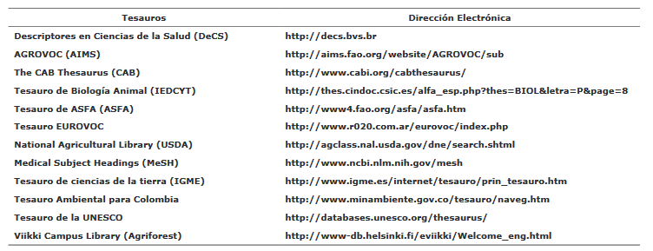
Keywords – index terms
They are short terms or phrases that allow for quick classification and direction of articles in indexing and search systems.
The number of keywords in most scientific journals ranges from 3 to 10.
They should be obtained from specific thesauri and are not arbitrary.
IEEE
https://www.ieee.org/content/dam/ieee-org/ieee/web/org/pubs/taxonomy_v101.pdf

Slide 41
Key words
They are a translation of keywords or index terms.
Must be done first in English based on the Taxonomy list and then be translated.
IEEE
https://www.ieee.org/content/dam/ieee-org/ieee/web/org/pubs/taxonomy_v101.pdf

Slide 42
Introduction
Introduction must include:
A paragraph that introduces the topic and highlights the relevance of the study.
A review of the state of the art with chronological or thematic citations.
A theoretical framework that sets the context for the topic (important equations, methods, etc.).
A paragraph describing the study's objectives.
An overview of how the article will be developed and its sections.
These parts do not need to be explicitly named as: Theoretical Framework, Historical Framework, or Hypothesis.

Slide 43
Acknowledgements
It consists of recognizing those who contributed to the research in any significant way, such as:
Significant technical or academic assistance received in the laboratory or elsewhere for conducting the research.
External financial collaboration through grants, contracts, or scholarships.
Time spent on the scientific review of the manuscript. Permission must be requested to mention a person or institution in the acknowledgments. Explicit consent should be obtained.
Acknowledgments should be strictly professional (not for family, friends, or partners).

Slide 44
References
References are organized by the number assigned to the citation, which corresponds to the order in which it first appears in the text.
It only includes the books, articles, websites, etc., that are cited within the document's text.
There are different citation styles, such as APA and IEEE, among others. This journal uses IEEE.
Journals describe in detail the format they expect authors to use. This format should be followed, even if it seems arbitrary.
It is recommended to use citation managers such as Jabref, Mendeley, or online tools like citethisforme.com.

Slide 45
References and Bibliography (General Recommendations):
They should rely on publications that can be corroborated and from reliable sources.
If they are citations taken from other works, reference the original document.
Do not cite theses or reports when the work has already been published in a recognized (indexed) journal. Cite the journal article.
Do not cite national journals when the same finding has already been published in an international journal.
Do not support with citations what is already known by the audience (e.g., scientific constants, etc.).

Slide 46
References and Bibliography (Formats):
Vancouver. BIOLOGY AND MEDICINE
Harvard. Harvard referencing. SOCIAL SCIENCES, NATURAL SCIENCES AND PHYSICS
Chicago. Chicago Manual of Style. University of Chicago de Chicago. HUMANITIES
APA. American Psychological Association. PSYCHOLOGY, SOCIAL SCIENCES
IEEE. Institute of Electrical and Electronics Engineers (IEEE) ENGINEERING

Slide 47
APA
Highlights:
Title of the source document or unit in italics
The author's last name is inverted but not emphasized
Tutorials and guidelines
Silvestrini, M. (2005). Como citar en APA. Recuperado el 21 de junio de 2007, de http://ponce.inter.edu/cai/CITAR_APA.pdf
Silvestrini, M. (2007). Repasando bibliografías impresas y electrónicas según APA. Recuperado el 21 de junio de 2007, de http://ponce.inter.edu/cai/manuales/REPASANDO_BIBL IOGRAFIAS_files/frame.htm
APA Style Manual

Slide 48
IEEE
Higlights :
The title of the article is in quotation marks.
The title of the source document or unit is in italics.
The last names of all authors are inverted.
The citation is made with a number. A very characteristic system: [Letter of the appendix + correlating number] [B35].
Tutorials y guidelines:
IEEE Referencing Style
IEEE Style Documentation (Univ. Toronto. Engineering Communication Center)

Slide 49
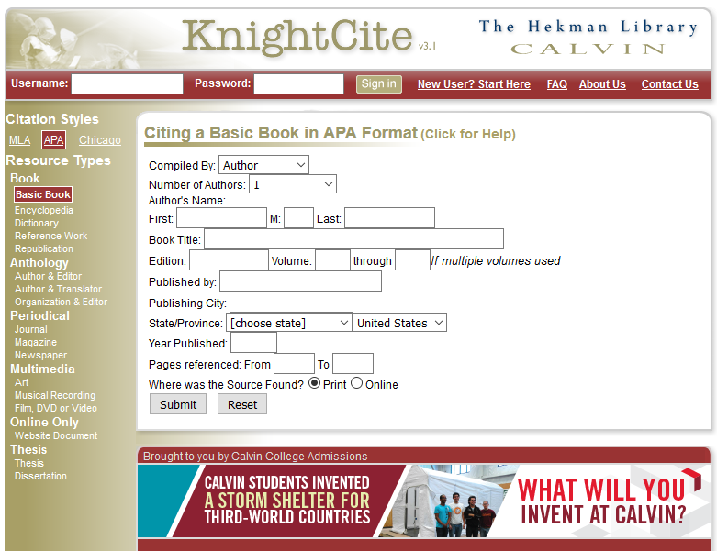
Online Citation Tools- APA
http://www.calvin.edu/library/knightcite/index.php

Slide 50
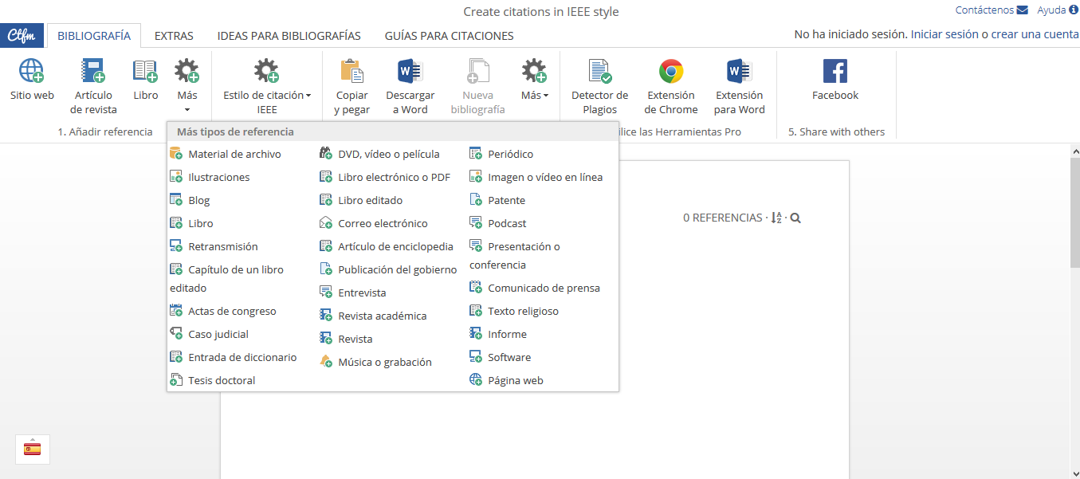
Online Citation Tools- - IEEE
https://www.citethisforme.com/es

Slide 51
Conclusions of the present work
There is no single format for writing scientific articles, but some general recommendations and journal-specific guidelines should be followed.

Slide 52
Questions to Answer
Summary/Abstract
What was done in essence?
Introduction
What is the problem?
Method
How was it investigated?
Results
What was found?
Discussion
What do the findings mean?
Conclusions
What is concluded?
Acknowledgements
Who contributed responsibly?
Referencias
What was reviewed and cited?

Slide 53
References
[1] Caivano, José Luis. Guía para realizar, escribir y publicar trabajos de investigación. Jose Luis Caivano, 1995.
[2] Heredia, Ana. ¿Por Qué Y Cómo Publicar Artículos Científicos En Revistas internacionales?. 1st ed. Santiago: Elsevier, 2015. Web. 22 Oct. 2015.
[3] Scimagojr.com,. 'SJR - Compare Countries'. N.p., 2015. Web. 22 Oct. 2015.
[4] Scimagojr.com,. 'SJR - Country Search'. N.p., 2015. Web. 22 Oct. 2015.
[5] Derntl, Michael. Basics Of Research Paper Writing And Publishing. 1st ed. Vienna: Department of Computer Science and Business Informatics, 2003. Web. 22 Oct. 2015.
[6] Colciencias.gov.co,. '¿Qué Es Un Proyecto De Investigación Cientifica Y Tecnólogica? | Colciencias'. N.p., 2015. Web. 22 Oct. 2015.

Slide 54
Editor and Presenter
Contact:
PhD. Jimmy Alexander Cortés Osorio
Cellphone: 3116212647
http://www.utp.edu.co
jacoper@utp.edu.co
Address:
Universidad Tecnológica de Pereira
Carrera 27 # 10-02 Álamos, Pereira, Colombia
South América
Zip code: 660003

